Slide 1
Version Control & GIT
Presented By:

Slide 2
$man git
NAME
git - the stupid content tracker
DESCRIPTION
GIT is a fast, scalable, distributed revision control system with an unusually rich command set that provides both high-level operations and full access to internals.

Slide 3
Theory (Simplified)
A Simplified Summary of Commit, Branches, and Merging

Slide 4
Commits
Initial Commit
Version B
Version A
Final Version
Commits
Represented as nodes on a graph.
Symbolize an instance (version) of a project’s files.
Can add, remove, or modify a file (or multiple files).
(Implementation) Features:
Copy on Write- Only save the changes

Slide 5
Branches
Main (Trunk):
Development:
Feature A:
Branch
A branch is a distinct variant of the project base.
Branches allow isolated environments for working on new features and fixes without disrupting the project.
Branches are created by “forking” from either the main branch (Trunk) or another branch.

Slide 6
Merging
Main (Trunk):
Development:
Feature A:
Merge
A branch may be merged into another.
The branch creates a “pull request” requesting that its present version be merged into another. The requestor details how to make the changes.
An authority from the branch being merged into then is expected to review the request.

Slide 7
The Case for Version Control
(Or How You Have Already Made It)

Slide 8
CASE A: Giant Undo Button
Implement a solution, doubt, and delete.
Is there a backup of an older version?
Is the older version the most recent?
What work, if any, must be redone (lost productivity)?
This is why backups are important
This is a fundamental tenant of version control.
Lesson 1: VERSION CONTROL AS BACKUP
Notes:
1) Fork A branch for development
2) Commit, and commit often.
3) Merge the polished result

Slide 9
Solution A: Save Incremental Changes
Master
Feature
Initial
Start a project or work from pre-existing
Fork
Fork a branch (They are Cheap): Contain Changes.
Rev. 0
Make some changes, then COMMIT THEM.
Rev. 1
Make more changes, then COMMIT THEM.
Final?
Make more changes, then COMMIT THEM.
Final
Merge Into the project branch.
Notes:
If you have previous copies, you HAVE previous copies.
Undo is only as useful as your commit habits.
You can REVERT to any previous COMMIT.
Warning COMMIT your existing CHANGES FIRST
Branch re-use is acceptable, but forking for incremental development is ENCOURAGED

Slide 10
CASE B: The New Breaks The Old
Fixing a smaller problem breaks a significant feature.
What changed?
First step in fixing the problem.
Humans SUCK at answering this question.
Can I revert the changes?
This is why version control is important.

Slide 11
Scenario B: Something Broke
Master
Feature
Initial
Start a project or work from pre-existing
Fork
Fork a branch (They are Cheap): Contain Changes.
Rev. 0
Break Something, and COMMIT.
Broke
Merge (LESSON 2: TEST YOUR MERGES)
Initial
Revert the Change (Backups are Amazing)
Rev. 1
Fix the Change, then COMMIT.
Next
Merge Into the project branch.
Notes:
This is the recommended workflow.
The KEY Mistake is NOT testing MERGE before COMMIT
Reverting the change ASAP minimizes the number of issues to be fixed by the MASTER branch.

Slide 12
CASE C: Multiple Copies
1 Implementation
5 Feature: A
2 Copy of Implementation
6 Feature: B
4 Copy of Copy of Implementation
7 Feature: C
9 Solution?
3 Copy2 of Implementation
8 Feature: D
Notes:
Tell a story about how to end up here…
# Sequence of Events
Blue – Revisions
Green – Implementations

Slide 13
(Tautological) Solution C: Version Control
Just
Use
Version
Control.
1. Base
5. Feature A
2. Copy
3. Copy2
Apply changes in B to A
REBASE (2)
6. Feature B
MERGE
8. Feature D
9. Feat. A+B
REBASE (4)
4. Copy of Copy
Apply changes in C to AB
MERGE
7. Feature C
10. A,B,C
REBASE (3)
Apply changes in D to ABC
11. A,B,C,D
MERGE
Notes:
REBASE – Changes the branch starting point to the (NEW) point, then applies the recorded changes to the new start.

Slide 14
Engineering: Applications
Why should I care?

Slide 15
CASE 1: Multiple Team Members
Multiple individuals need to work on the same file.
Option A: Only one may work on the file at a time (Checkout Model).
Option B: Everyone gets a copy, but you must reconcile the differences.
File
Copy A
Copy B
Merged

Slide 16
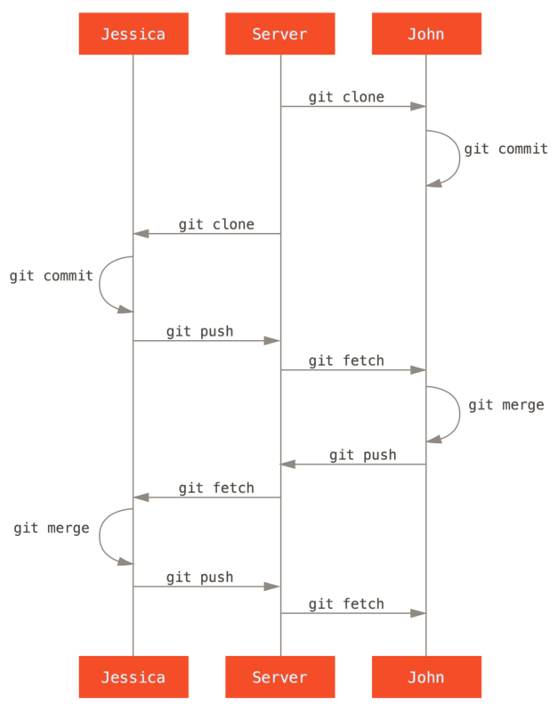
Solution 1: User Branches
GIT follows Option B.
Some overhead reconciling differences is created.
GIT’s model requires changes be made with respect the current version.
Remember REBASE.

Slide 17
CASE 2: Everything is Broke
Changes are made irresponsibly.
Commits track whom made the change.
“BLAME” Cites whom made the previous change(s)
“DIFF” allows side-by-side comparison of versions logging additions, changes, and removals.

Slide 18
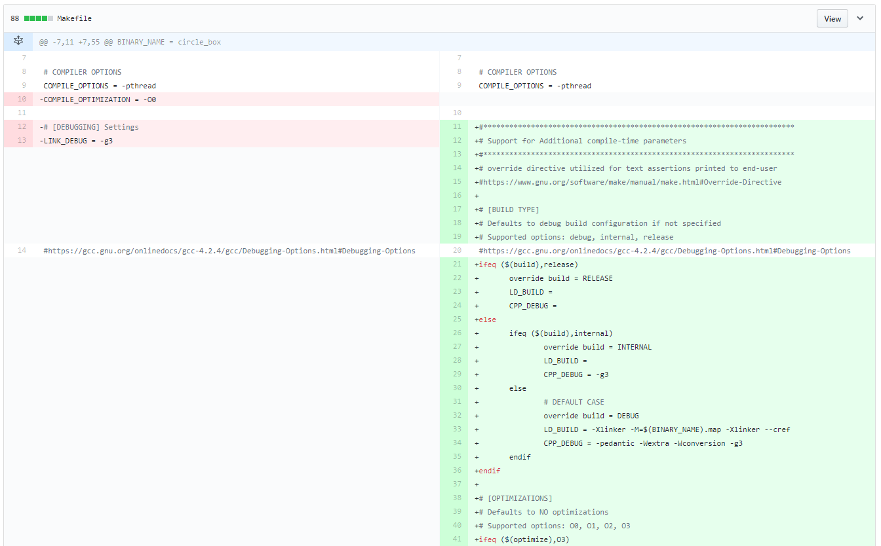
Solution 2: Diff
GitHub (3rd Party) Implementation
-{Removed}
+{Added}
Note: Plain text files work best.
Binary files are not supported.

Slide 19
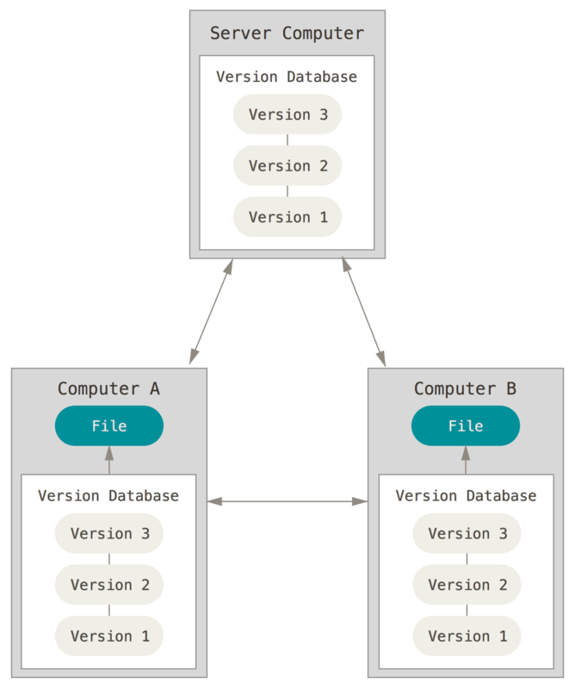
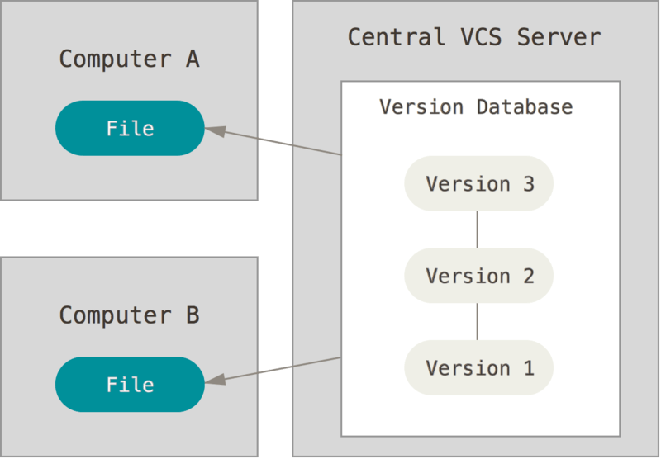
CASE 3: No (Internet) Connection
Distributed Version Control
The user “clone” a repository.
The copy is a complete version
GIT uses this model.
Centralized Version Control
The user has copies of files.
The repository only on the server
Subversion (SVN) uses this model.

Slide 20
Getting Started
GIT
https://git-scm.com/downloads
Choose a license
https://choosealicense.com/
Configure .gitignore
https://www.gitignore.io/
Consider a Web Front-End
https://education.github.com/pack (Recommended)
https://about.gitlab.com/pricing/

Slide 21
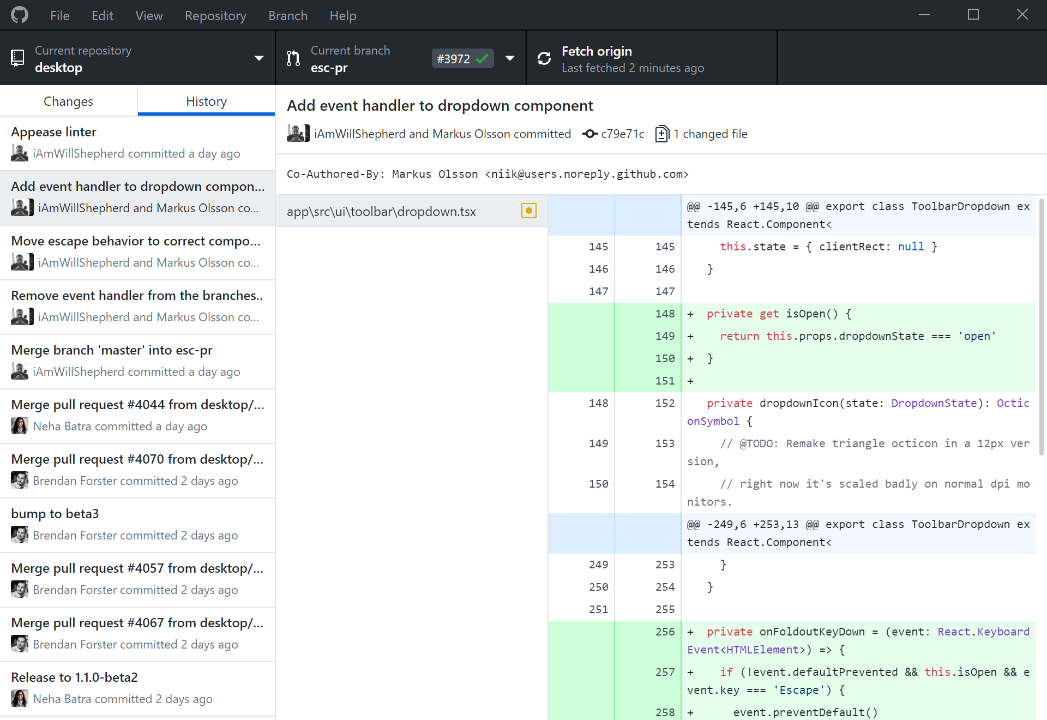
Try GitHub’s Desktop Client
https://desktop.github.com/

Slide 22
Simple GitHub Usage

Slide 23
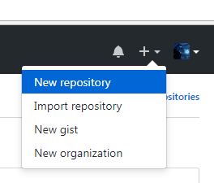
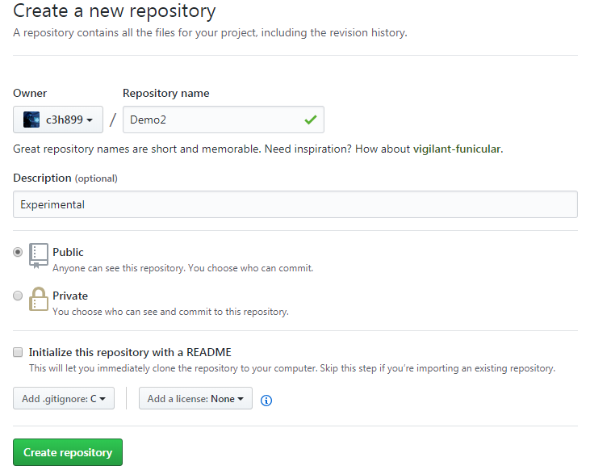
Create a New Repository
As a student, Private repositories are free. USE THEM

Slide 24
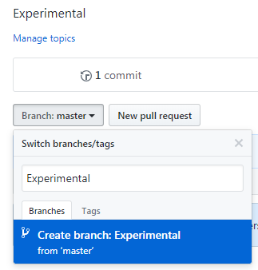
Create an Experimental Branch
1. Click Here
2. Give it a Name
3. Create the Branch

Slide 25
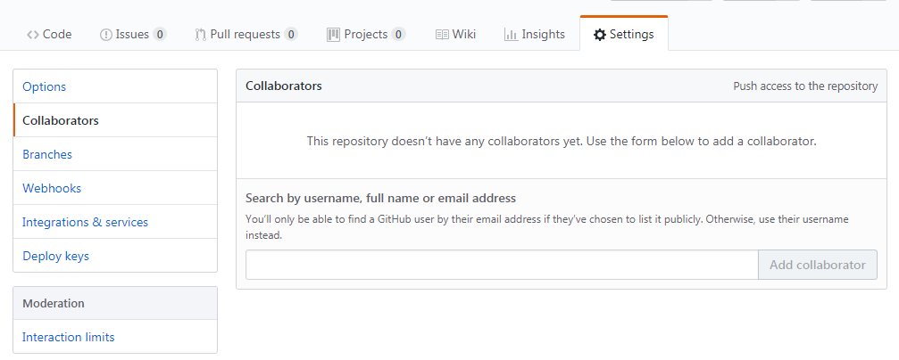
Add Collaborators (Optional)
(1)
(2)
(3)

Slide 26
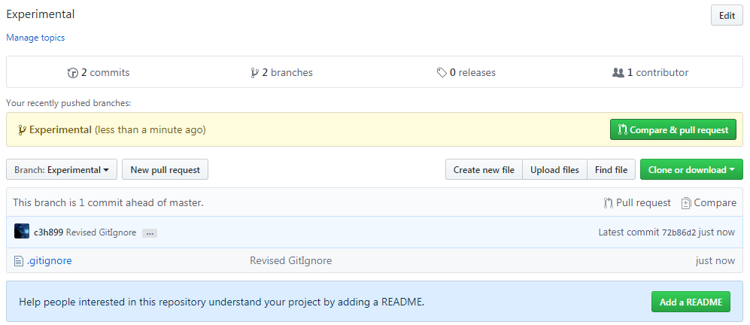
Merging Branches (Pull Request) 1/3
1. Click Here

Slide 27
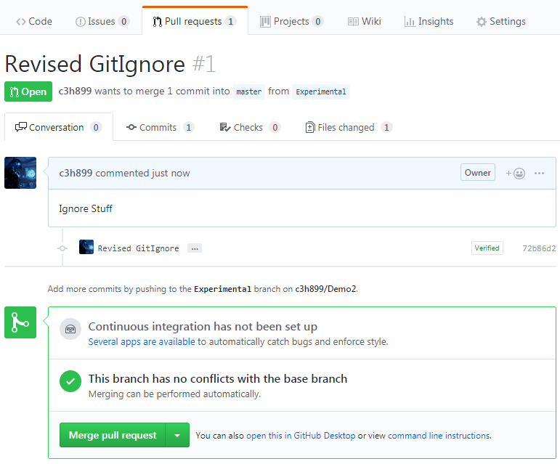
Merging Branches (Pull Request) 2/3
1. Annotate the Request
2. Open the Request

Slide 28
Merging Branches (Pull Request) 3/3
Merge

Slide 29
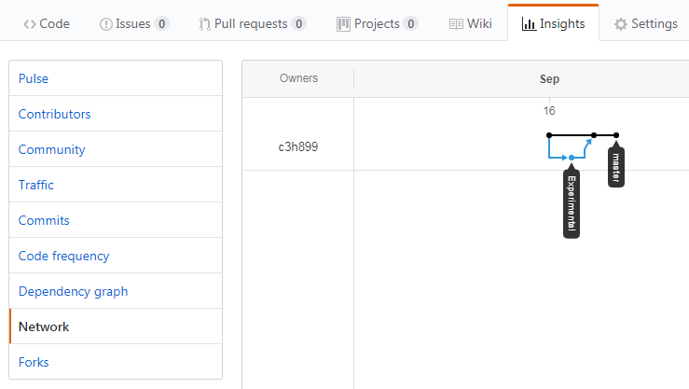
Neat Graphs
(1)
(2)

Slide 30
Additional References
GIT SCM (Official Site)
https://git-scm.com/
git - the simple guide
https://rogerdudler.github.io/git-guide/
GitHub GIT CHEAT SHEET
https://services.github.com/on-demand/downloads/github-git-cheat-sheet.pdf

Slide 31
Citations
Figures from the CASE section: ProGit 2nd Edition (2014) by Scott Chacon and Ben Straub released under a CC NC SA license.
GitHub Diff from GitHub.com

